Slide 1
ANLT 272 Final Project
Francis Segbe

Slide 2

Introduction: Objective and Methodology
Objective:
Our objective for this assignment is to find variables that are associated to Heart Failure Survival.
Methodology:
We will perform appropriate Chi-Squared Test, Wilcoxon Rank Test, or T-Test to determine if a variable is associated to Heart Failure Survival.

Slide 3
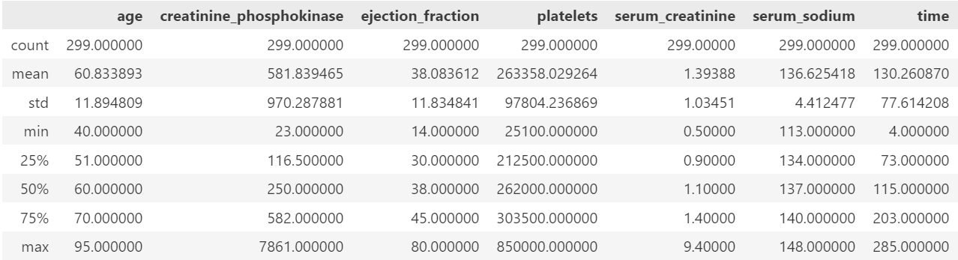
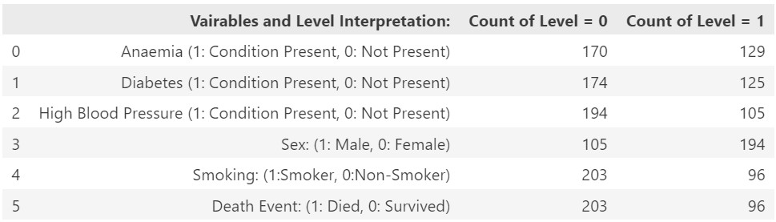
General Info About Our Data Set:
Summary of Numeric Variables:
Source: Kaggle.
The original data collectors recorded 13 different features for 299 patients who experienced heart failure.
Of 299 patients, 203 survived, and 96 died.
There are 7 numerical features and 6 binary features.
Our primary variable of interest is the death event, which indicates if the patient died.
Summary of Binary Variables:

Slide 4
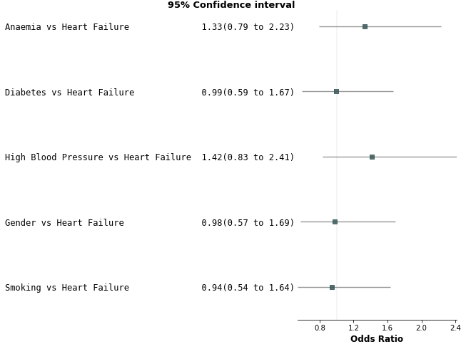
Odds Ratio Exploration
The plot to the right shows the point estimate and 95% confidence interval for the Odds Ratio between a binary predictor and the Heart Failure Survival variable.
The value 1 is contained in each of the confidence interval shown.
This indicates that we would not expect Chi-Sq test to show that there is association between any of these potential predictors and the Heart Failure Survival variable.

Slide 5
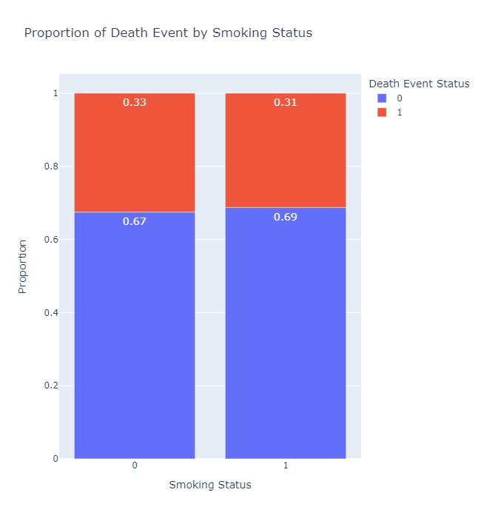

Smoking Status and Heart Failure Survival.
We first explored if there is an association between Smoking and Heart Failure using a Chi-Sq Test.
The hypothesis for this test are:
H0: There is no association between Smoking and Heart Failure
H1: There is association between Smoking and Heart Failure
The test results are shown in the table to the bellow.
Based on the results of the Chi-Sq , we fail to reject the notion that there Smoking and Heart Failure Survival aren’t associated.
Results of the Chi-Sq Test:

Slide 6
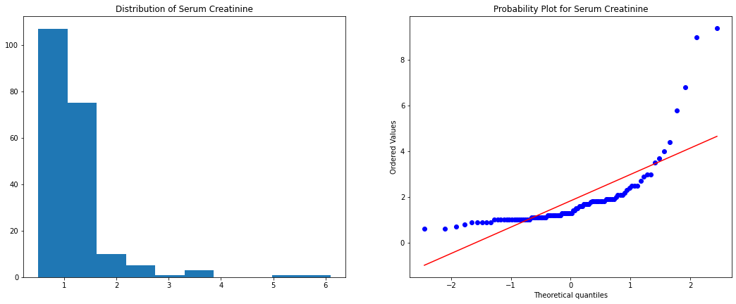

Serum Creatinine and Heart Failure Survival:
We next explore if there is a relationship Serum Creatinine and Heart Failure variables using a Wilcoxon Rank Test (Based on the distribution of the variable).
The hypothesis for this test are:
H0: The Median Serum Creatinine Levels are same Heart Failure levels.
H1: The Median Serum Creatinine Levels are different Heart Failure Survival levels.
The test results are shown in the table to the right.
Based on the results of the Rank Test performed , we reject H0 and conclude the median Serum Creatinine Levels are different Heart Failure levels.
Overall Distribution of Serum Creatinine:
Results of the Wilcoxon Rank Sum Test:

Slide 7
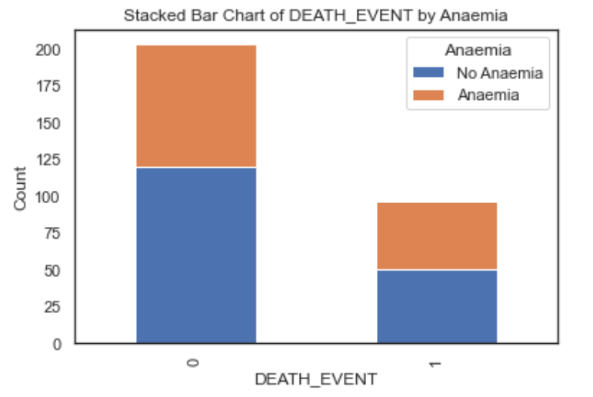

Anaemia and Heart Failure Survival:
We performed an analysis to determine if there is an association between anemia diagnosis and heart failure. Anemia can potentially be a risk factor for heart failure.
The hypothesis for this test are:
H0: There is no association between anemia status and heart failure survival.
H1: There is an association between anemia status and heart failure survival.
The test results are shown in the table to the right.
Applying the Chi-squared test yielded a test statistic of 1.042 and a p-value of 0.307. With a significance level of 0.05, we fail to reject the null hypothesis since the p-value is greater than 0.05.
Therefore, based on this sample, there is not sufficient evidence to conclude that there is a statistically significant association between anemia status and heart failure diagnosis. Further investigation may be warranted with a larger sample size.
Results of the Chi-Sq Test:

Slide 8
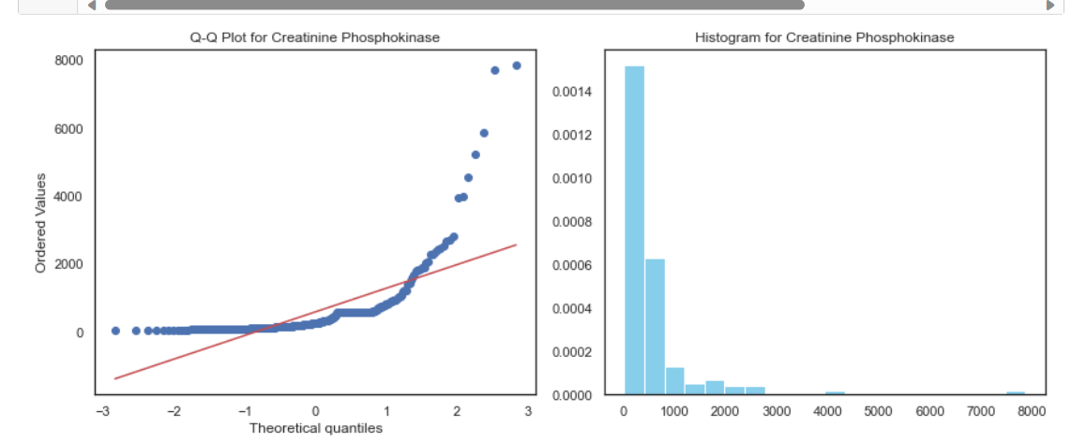

Creatinine_phosphokinase and Heart Failure Survival:
We performed an analysis to determine if there is an association between creatine phosphokinase levels and heart failure diagnosis. Elevated creatine phosphokinase can be indicative of cardiac muscle damage
The Mann-Whitney U test was used to assess whether median creatine phosphokinase levels differ between patients with and without heart failure. This non-parametric test was selected since the enzyme values deviated from normality.
The hypothesis for this test are:
H0: The median creatine phosphokinase levels are equal in heart failure survival and non-heart failure patients.
H1: The median creatine phosphokinase levels differ between heart failure survival and non-heart failure patients.
The test results are shown in the table to the right.
Applying the Mann-Whitney U test yielded a test statistic of 9,420 and a p-value of 0.68. With a significance level of 0.05, we fail to reject the null hypothesis since the p-value is greater than 0.05.
Therefore, based on this sample, there is not sufficient evidence to conclude that median creatine phosphokinase levels differ significantly between heart failure and non-heart failure patients. Further investigation may be warranted with a larger sample size or more targeted cardiac enzyme tests.
Overall Distribution of Creatinine_phosphokinase:
Results of the Mann-Whitney/Wilcoxon Rank Sum Test:

Slide 9
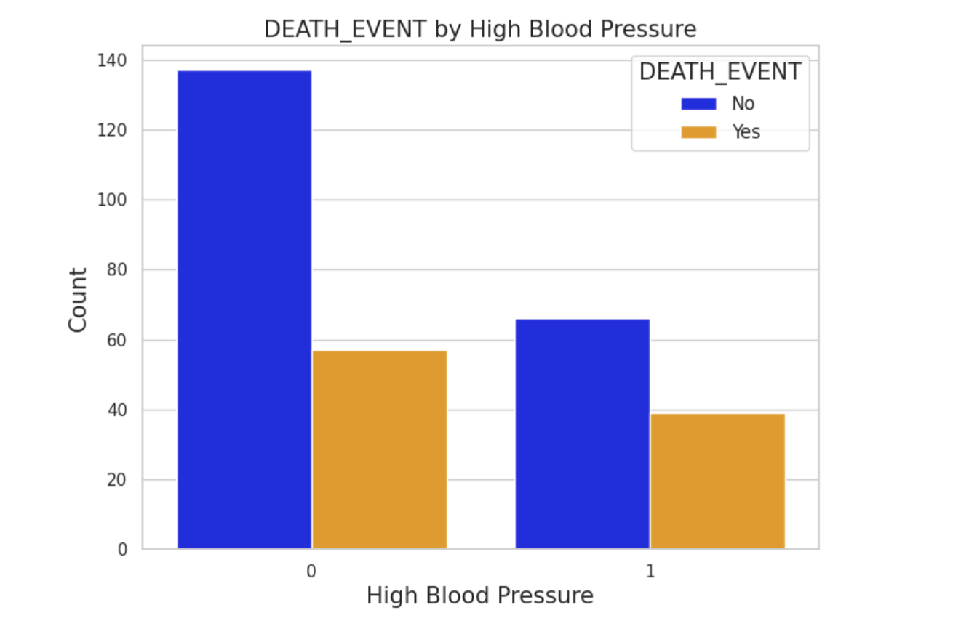
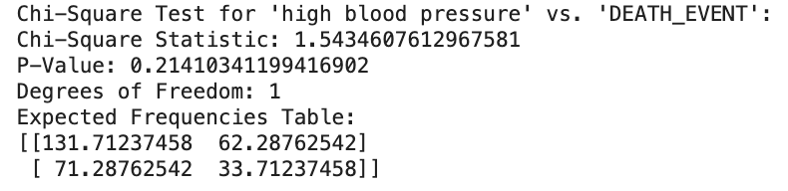
Heart Failures by High Blood Pressure

Slide 10
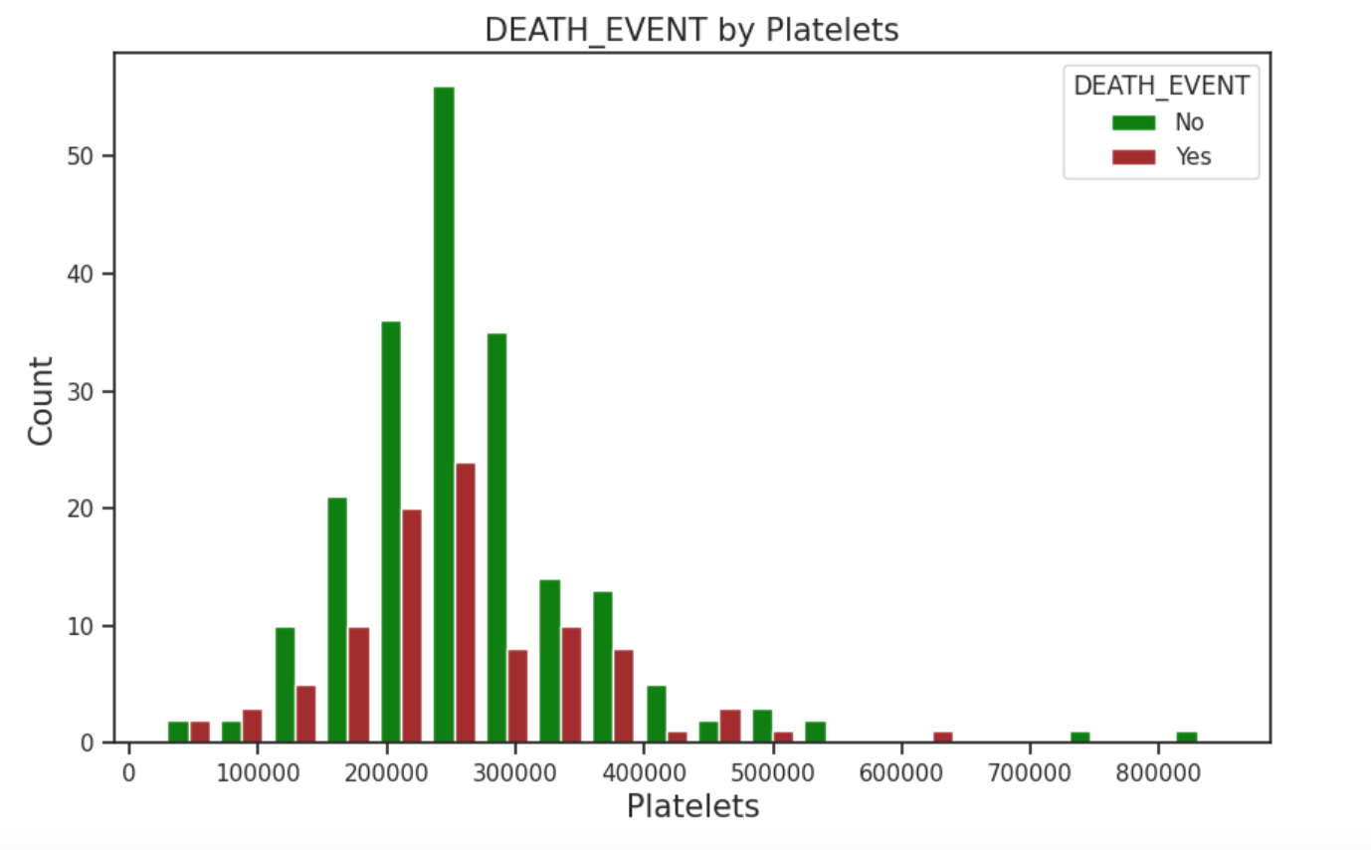
Heart Failure by Platelets

Slide 11
Conclusion and Future work:
Of the variables explored, only Serum Creatinine was found to be associated to heart failure survival.
In future works, we would explore binary classifiers to try to predict heart failure survival (e.g. Logistic Regression, KNN, etc.).

